Slide 1
TRANSFORMING EDUCATION ONE CHALLENGE AT A TIME
A STEAM program for pre-K, K-12 and university students

Slide 2
AGENDA
WHAT
WHO
WHY
HOW
QUESTIONS

Slide 3
What is Destination Imagination?
Self-Confidence
Destination Imagination (DI) is a team-based creative problem-solving competition
Students work in teams to create a solution to a Challenge
Teams attend an in-person or virtual tournament to share their solutions
Problem Solving
Team Building
Creative & Critical Thinking
Perseverance
Project Management
Risk Taking
WHAT

Slide 4
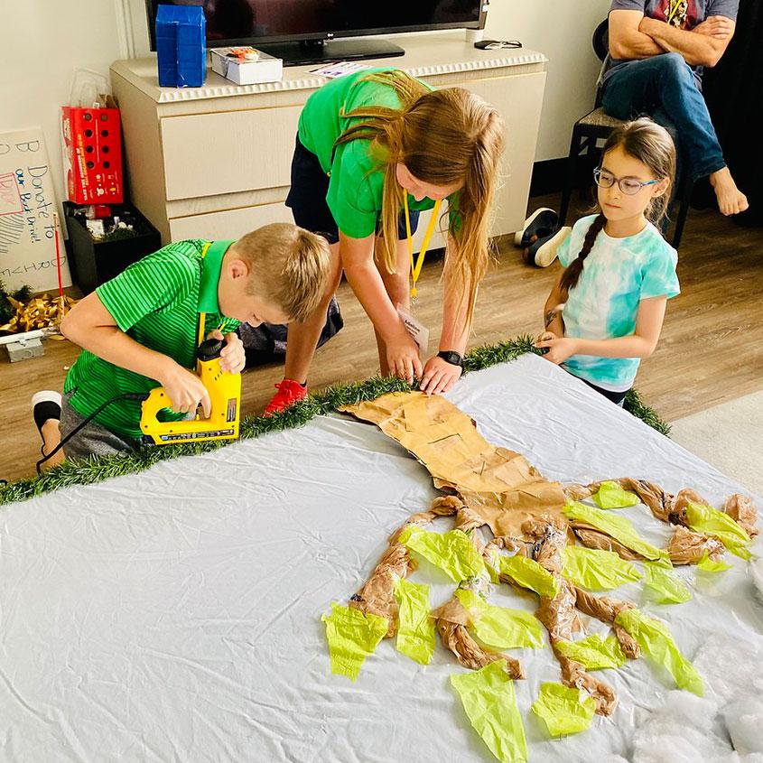
The Challenge Experience
The Challenge Experience includes six competitive Challenges rooted in STEAM (science, technology, engineering, arts, and mathematics) concepts.
Our Challenges are developed annually with the help of educators, subject matter experts, and qualified volunteers.
Each Challenge encourages students to explore their passions, discover their own talents and abilities, and learn life skills.
WHAT

Slide 5
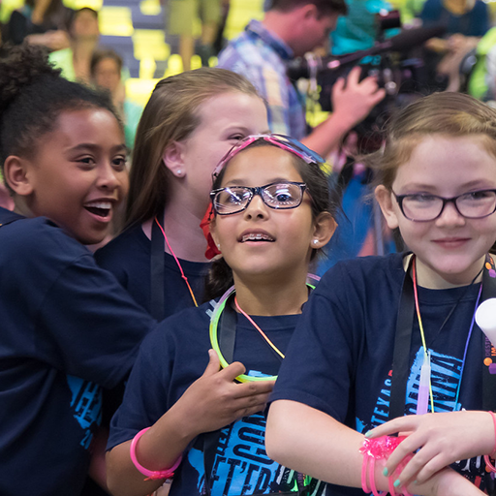
The Challenge Experience
Open to all kindergarten through university level students worldwide.
Student teams of up to seven members select their Challenge and work together to develop a solution.
Each team has at least one Team Manager to help keep the team on track, but does not assist or interfere with the team’s solution. This volunteer role is typically filled by a parent, teacher, or community member.
Teams share and celebrate their innovative Challenge solutions at a virtual or in-person tournament.
WHAT

Slide 6
TEAM CHALLENGE CATEGORIES
WHAT

Slide 7
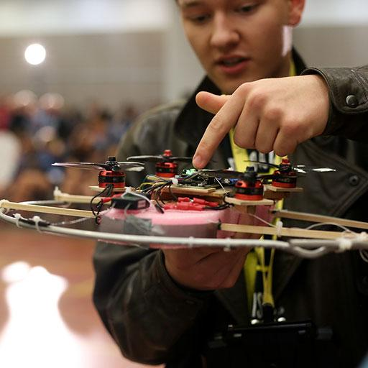
Who doesn’t love a good puzzle? Your team will explore the thrill of finding that crucial piece or clue that brings the whole thing together. Puzzle it out in this season’s Technical Challenge!
Design and create a puzzle that will be assembled during the Presentation.
Design and build 2 puzzle solvers that use technical methods to assemble the puzzle.
Create and present a story about how a character’s understanding changes at a pivotal moment.
Create and present two Team Choice Elements that show off the team’s interests, skills, areas of strength, and talents.
WHAT

Slide 8
Zoooom, whoosh, weeeee! Design and test your very own roller coaster, complete with unexpected twists and turns. Join us for a wild ride as you explore this season’s Engineering Challenge!
Design and build a roller coaster that will be assembled and then tested during the Presentation.
Design and create a launching mechanism that starts moving a golf ball along the roller coaster track.
Test how far and how fast the golf ball can travel through the roller coaster.
Create a Presentation that shows what the riders would experience when riding the roller coaster.
Create and present two Team Choice Elements that show off the team’s interests, skills, areas of strength, and talents.
WHAT

Slide 9
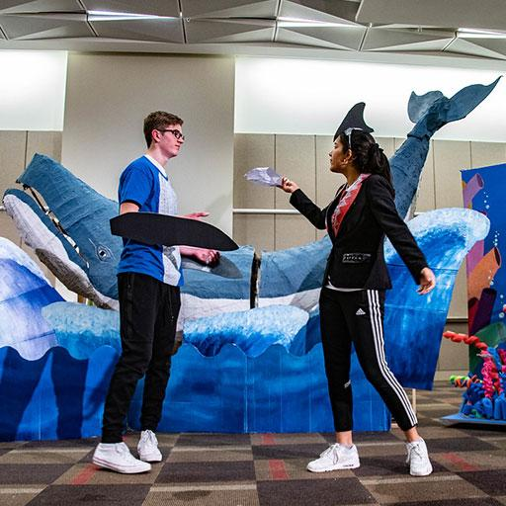
Have you ever heard a story that seemed too amazing to be true? In this season’s Scientific Challenge, your team will show how science can be used to put the impossible to the test. Is the story fact, or is it just a tall tale?
Present a team-created story in the style of a tall tale.
Include an exaggerated character with a hyperbolic trait.
Design and build a theatrical embellishment that enhances the hyperbolic trait.
Present a scientific analysis to determine whether or not the exaggerated character could actually exhibit the hyperbolic trait(s) as described in the tall tale.
Create and present two Team Choice Elements that show off the team’s interests, skills, areas of strength, and talents.
WHAT

Slide 10
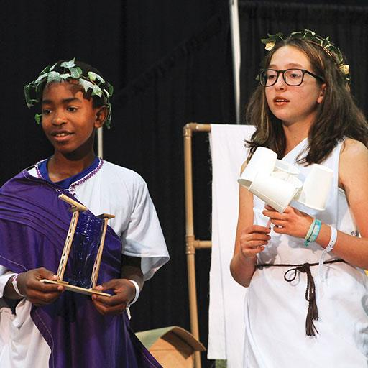
Sometimes the story you know isn’t the whole story. Explore what happens when the focus of a story changes. It’s time to put your own twist on a well-known tale in this season’s Fine Arts Challenge!
Create and present a flipped tale that is inspired by a well-known story but focuses on a new main character.
Research literary devices and integrate one into the Presentation.
Use theatrical techniques to move the audience’s focus from one portion of the Presentation Area to another.
Design and build a piece of scenery that goes through a scenery flip.
Create and present two Team Choice Elements that show off the team’s interests, skills, areas of strength, and talents.
WHAT

Slide 11
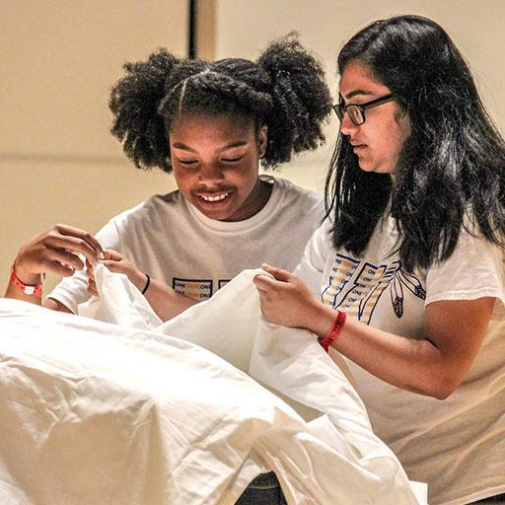
We all love to root for an underdog. In this season’s Improvisational Challenge, your team will use your improv skills to tell a story about an unlikely hero who rises to a challenge. Will they emerge victorious, or will they crumble under the pressure?
Create and present an improvisational skit about an underdog preparing for and/or participating in a competition.
Incorporate an expert into the skit.
Integrate a complication into the skit.
Enhance the skit with trash bags and rubber bands.
WHAT

Slide 12
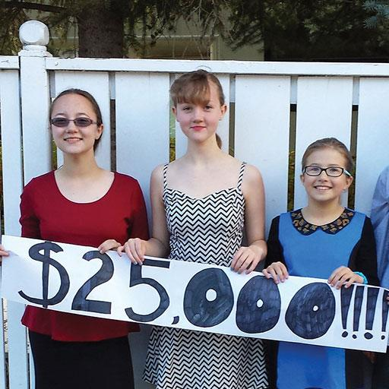
It takes a lot to make the world a better place. You’ve put it all on the line—will it pay off? The clock ticks and the pressure builds in this season’s Service Learning Challenge.
Identify, design, carry out, and evaluate a project that addresses a need in a real community.
Create and present a suspenseful story about a high-stakes situation.
Include a slow-motion scene that is enhanced by a special effect.
Create and present two Team Choice Elements that show off the team’s interests, skills, areas of strength, and talents.
WHAT

Slide 13
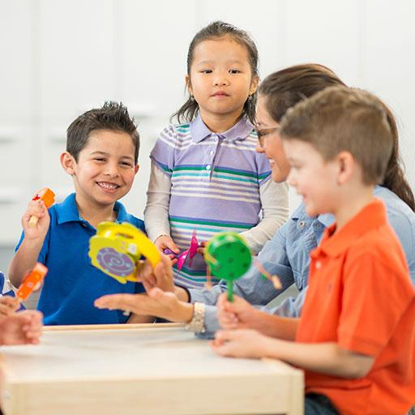
Music can bring a story to life. Unleash your inner musician as you create your own instruments and use music to tell a story about friends going on a fantastic adventure. This season’s Early Learning Challenge will be music to your ears!
Create and present a play about a group of friends going on a fantastic adventure together.
Include a musical character.
Create musical instruments and use them to perform a song.
Create costumes, props, and scenery to help tell the story.
WHAT

Slide 14
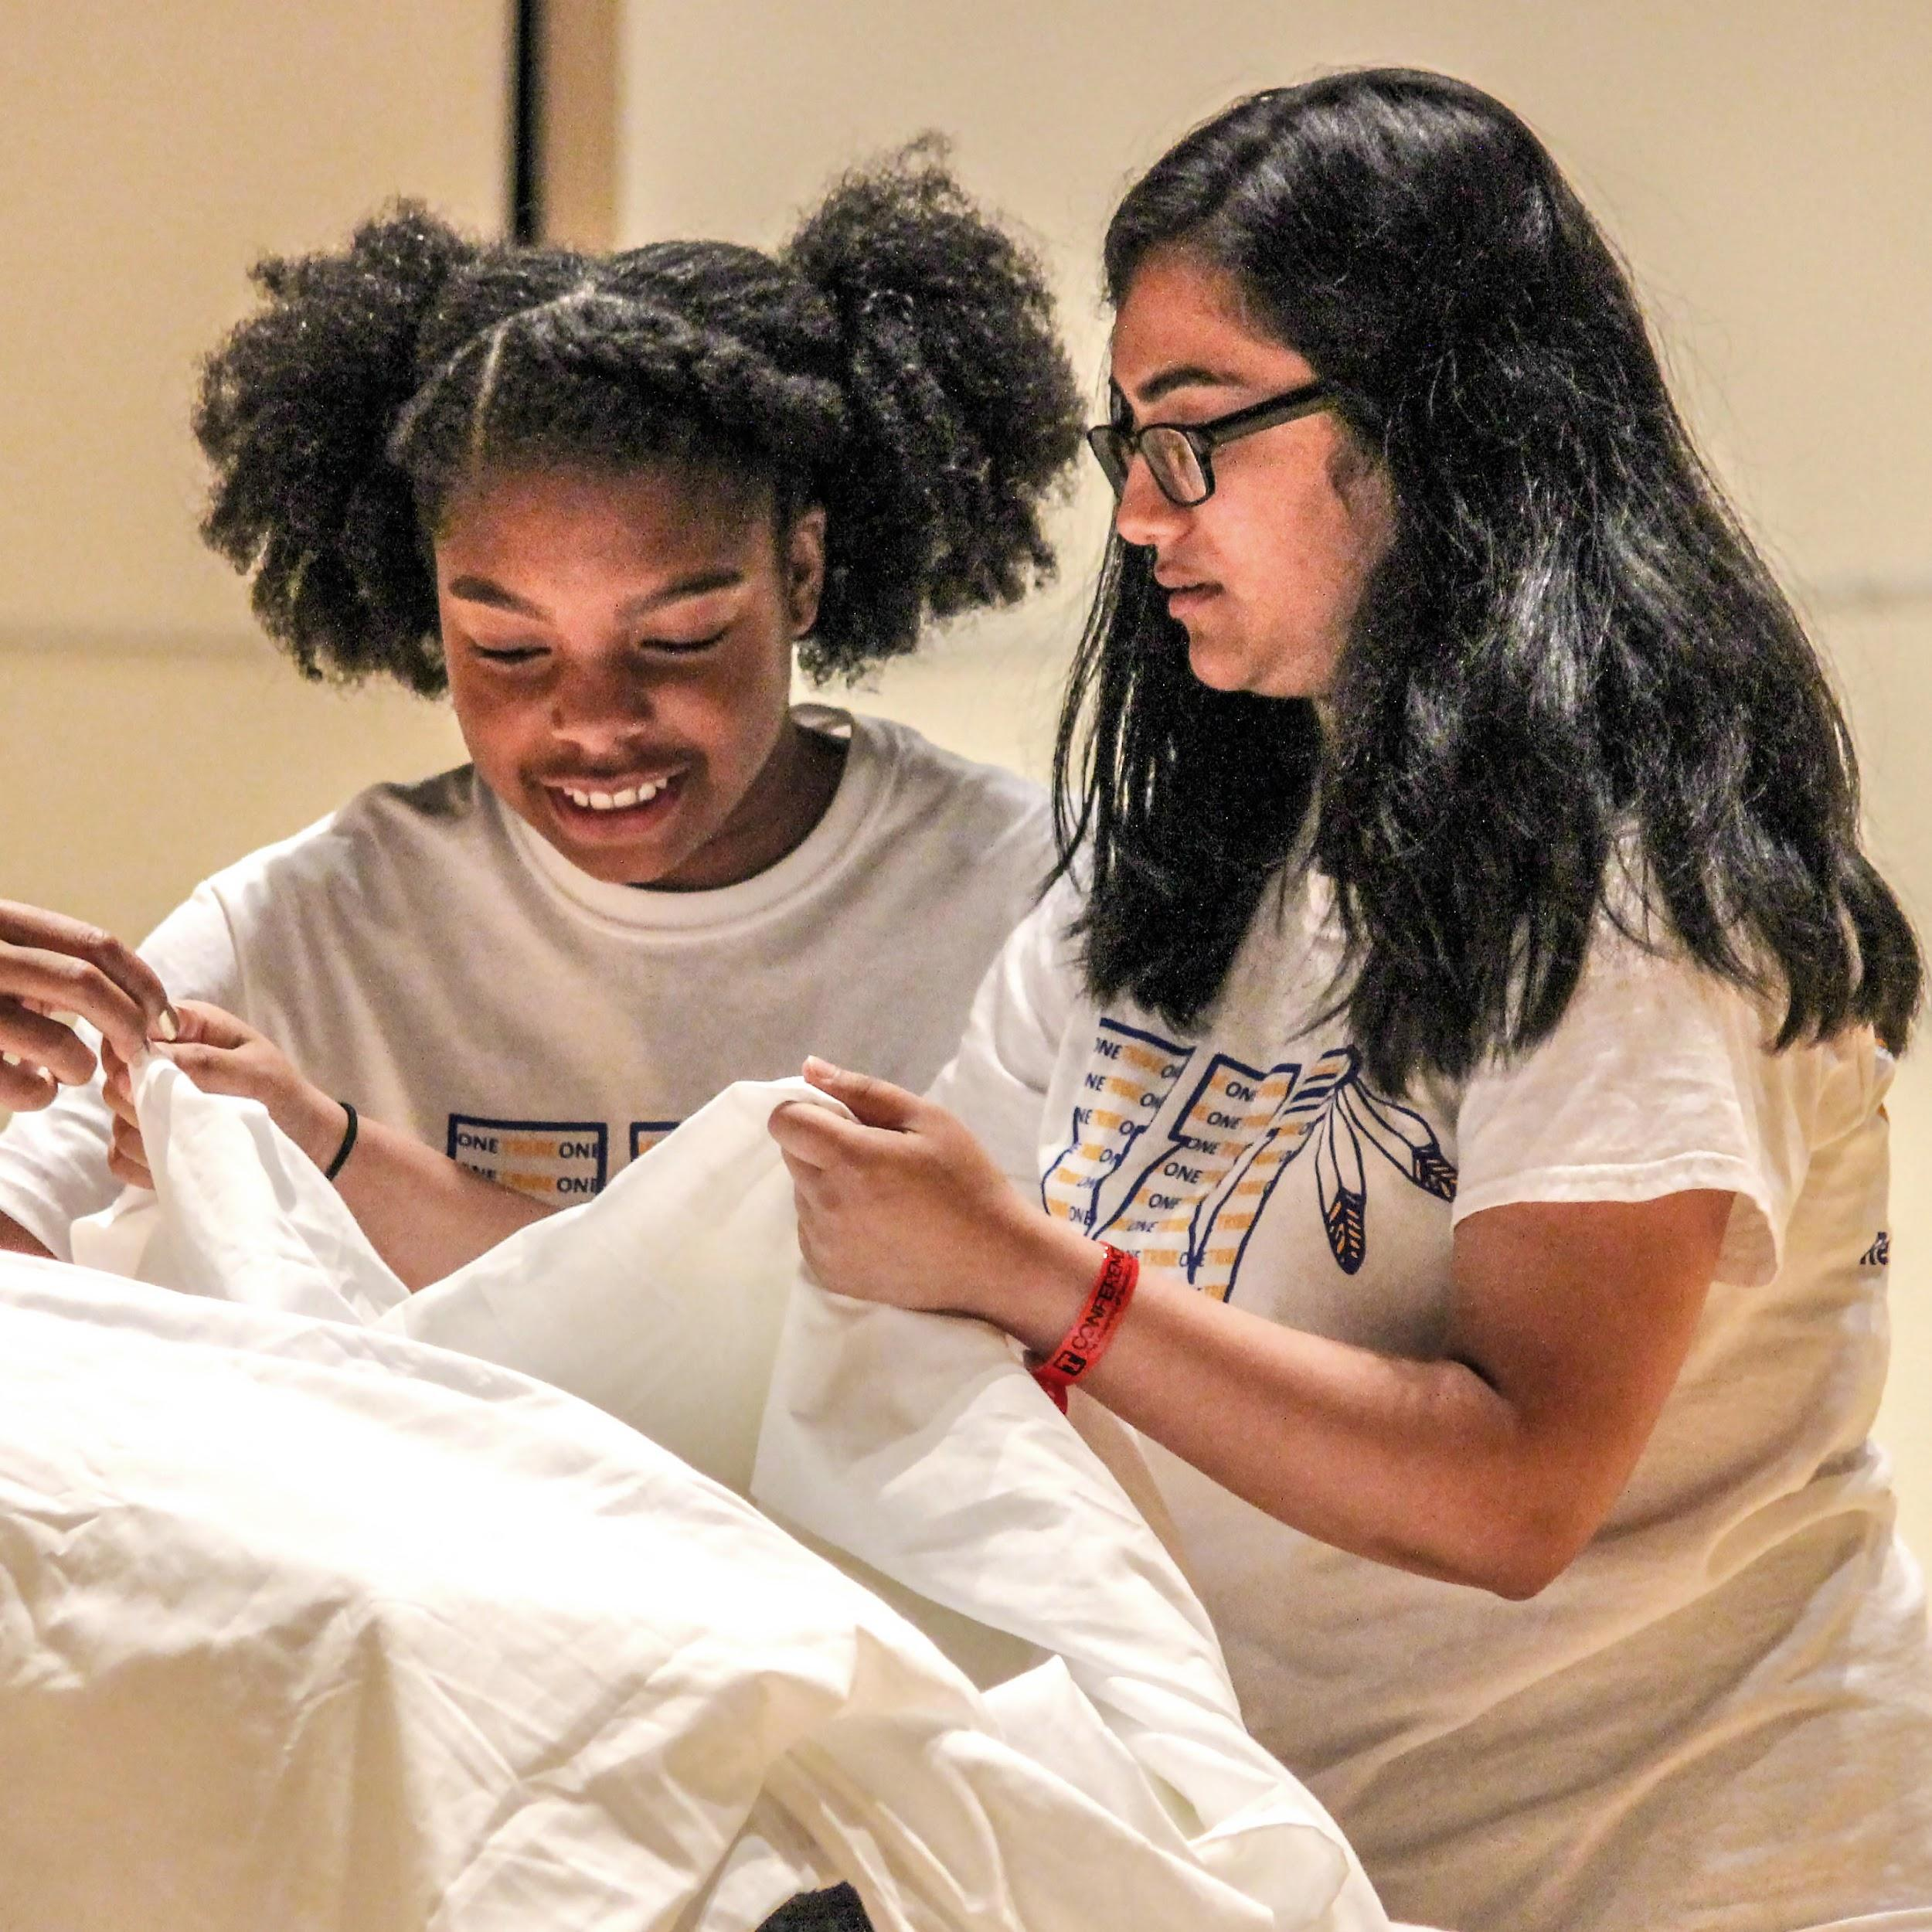
In a world with growing cultural connections, increased levels and types of communication, and a new need for real-time teamwork and problem-solving, the ability to solve problems quickly is becoming increasingly critical.
Each team will be asked to solve an Instant Challenge for their DI tournament. The team must think on their feet by applying appropriate skills to produce a solution in a short period of time.
Instant Challenges are performance-based, task-based, or a combination of the two. Although each Instant Challenge has different requirements, all Instant Challenges reward teams for their teamwork. Instant Challenges are kept confidential until it is time for teams to solve them.
WHAT

Slide 15
Flying Feather
Challenge
Build the tallest possible structure, place a feather on the top, and then blow the feather off to land as far away as possible.
Time
You have 5 minutes to use your teamwork, creativity, and innovation skills to build the structure with the materials provided. You will then have one chance to blow the feather as far as you can.
The Scene
You have been asked to build a new prop for the sequel to The Muppets. The structure must be freestanding on the table top and must be as tall as possible so that the feather can fly a long distance. After the 5-minute build time, the height of the structure will be measured. You will then place the feather on the top of the structure and, with one large puff of air, see how far the feather will fly.
Materials
Aluminum foil, 2 paper clips, 4 straws, 3 sheets of paper, 4 pipe cleaners, 1 label, 1 feather
WHAT

Slide 16
The Digital Open is a virtual challenge designed for teams that want or need a flexible learning experience—in person, virtual, or hybrid. Each year, we create a unique challenge that requires a digital solution. Solutions are appraised and teams are ranked in this one-of-a-kind global competition.
Learn more at: DestinationImagination.org/Digital-Open
WHAT
Notes:
Remove this slide if you are presenting after Oct 11th

Slide 17
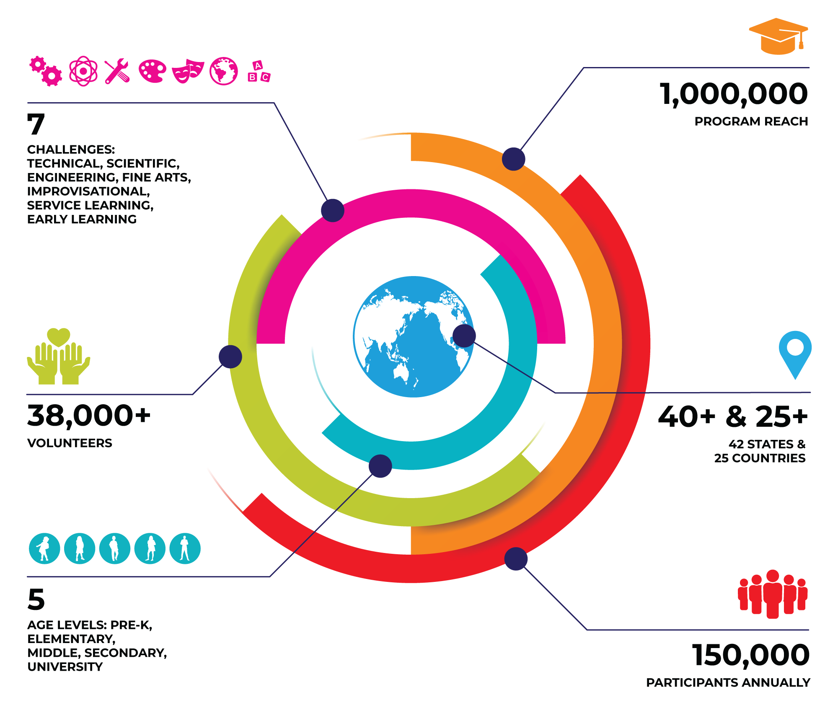
OUR
COMMUNITY
WHO
Notes:
Please note that these are our pre-pandemic numbers.

Slide 18
Who does Destination Imagination?
STUDENTS
TEACHERS & ADMINISTRATORS
VOLUNTEERS
PARENTS & GUARDIANS
ALUMNI
WHO

Slide 19
The Workforce of the Future
Though we don’t know what these jobs will look like, we know the skills that will be needed — skills that DI helps students gain, including creative problem-solving, critical thinking, and project management.
60% of CEOs polled cited creativity as the most important leadership quality, compared with 52% for integrity and 35% for global thinking.
– IBM Global CEO Study
65% of today’s students will be employed in jobs that have yet to be invented.
– U.S. Department of Labor
WHY

Slide 20
U.S. Team Pricing
Ready to get started? Visit ShopDI.org to purchase a Team Number.
TEAM NUMBER
$110*/ Per Team
BACKGROUND CHECK
$25/ For Team Managers
Destination Imagination administers its Team Challenges through state and country Affiliates worldwide. To participate in a tournament, teams must register with their Affiliate. There are additional fees for Affiliate administration, Affiliate Tournaments and Challenge budgets. Some Affiliates have directed DI headquarters to collect their Affiliate fees* with the purchase of your Team Number.
*Affiliate fees vary and are at the discretion of each individual Affiliate.
HOW

Slide 21
Team Number Volume Discounts
Buy 10 or MORE Team Numbers and Save!
10-19
TEAM NUMBERS
20-49
TEAM NUMBERS
50-99
TEAM NUMBERS
100+
TEAM NUMBERS
SAVE 5%
SAVE 10%
SAVE 15%
SAVE 20%
HOW

Slide 22
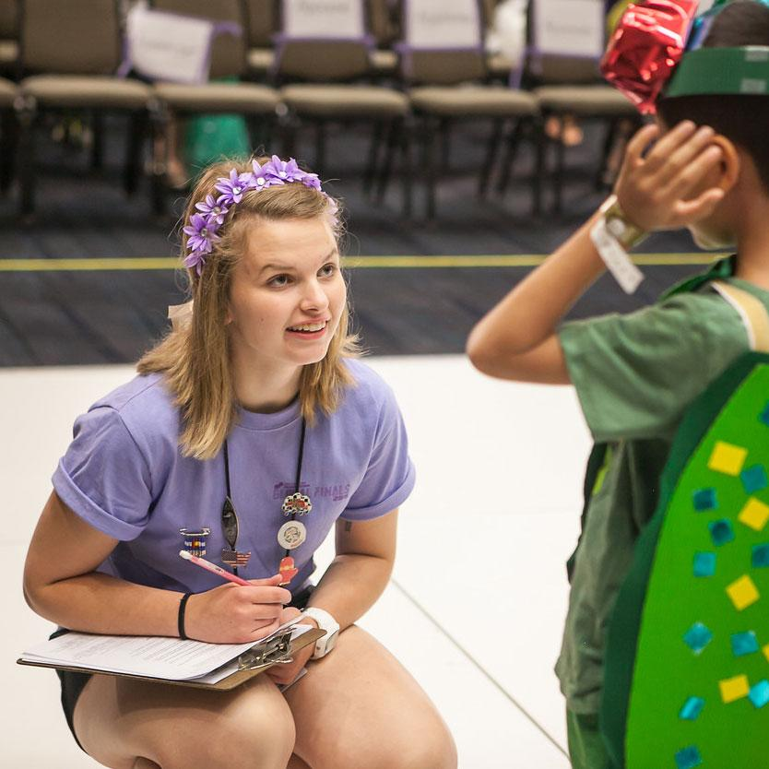
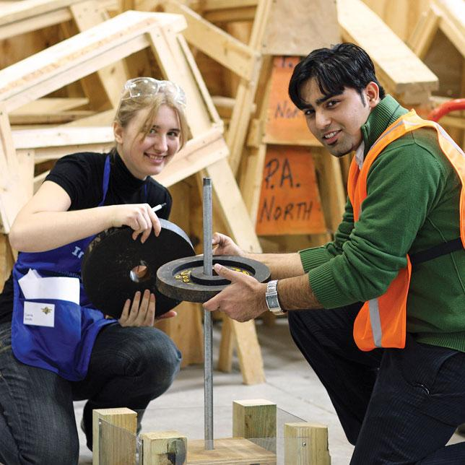
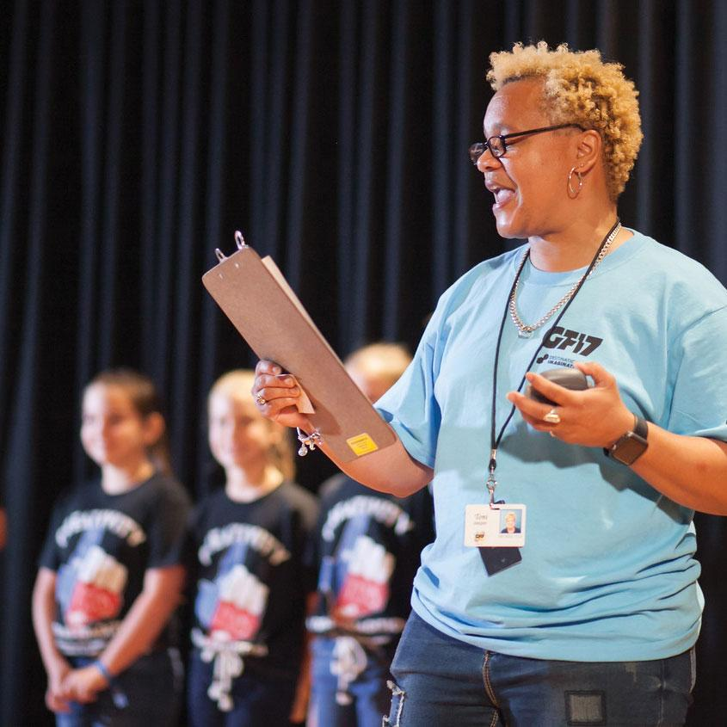
Volunteer Opportunities
Being a DI volunteer allows you to connect with a growing network of engaged and passionate individuals who believe that the power of creativity can impact the lives of our learners. To learn more about the various volunteer opportunities within DI, visit DestinationImagination.org/Volunteer.
HOW

Slide 23
Questions
Thank you! For additional information, please contact:
HOW

