Slide 1
A STEAM program for pre-K, K-12 and university students
TRANSFORMING EDUCATION ONE CHALLENGE AT A TIME

Slide 2
AGENDA
WHAT
WHO
WHY
HOW
QUESTIONS

Slide 3
What is Destination Imagination?
Self-Confidence
Destination Imagination (DI) is an educational nonprofit.
Our mission is to inspire and equip youth to imagine and innovate through the creative process.
We want to ignite the power of ALL youth to be the creative and collaborative innovators of tomorrow.
Problem Solving
Team Building
Creative & Critical Thinking
Perseverance
Project Management
Risk Taking
WHAT

Slide 4
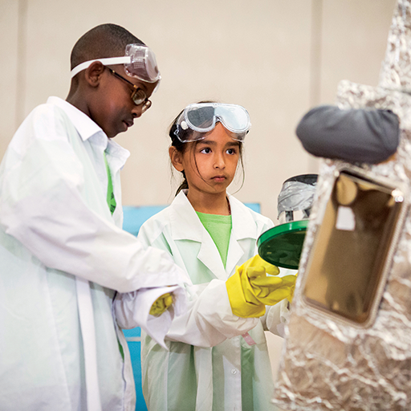
DI’s Challenge Experience is a project-based academic competition in which students work in teams to solve open-ended Challenges
Each of our seven, annual Team Challenges has a different educational focus:
Scientific
Technical
Engineering
Fine Arts
Improvisational
Service Learning
Early Learning
WHAT
Notes:
Image description: Two middle school students dressed in lab coats and safety goggles working together on their Destination Imagination Presentation.

Slide 5
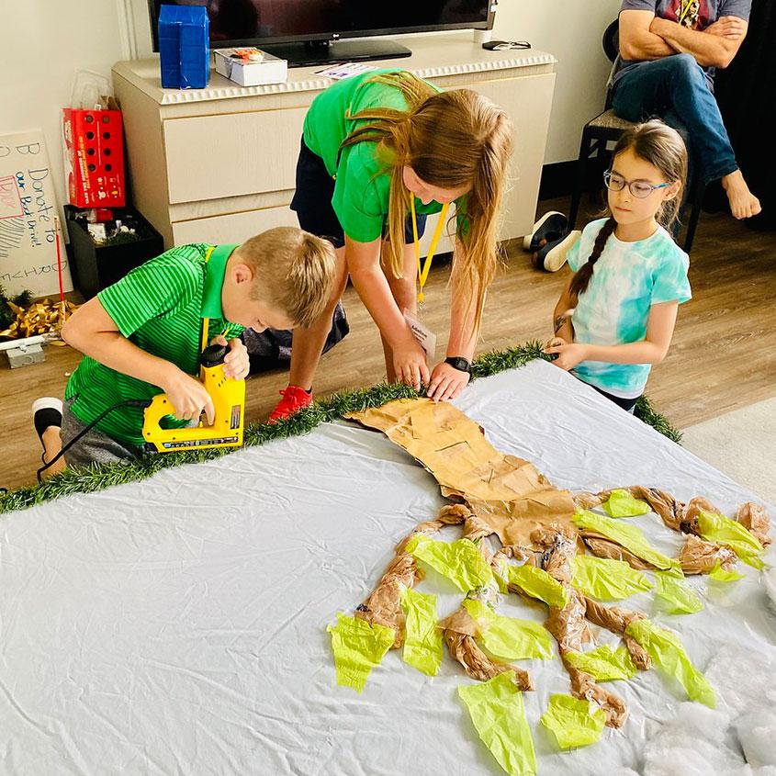
Each team selects one of our Team Challenges, and then works on their solution over several weeks or months.
A solution is a presentation that is then brought to a local tournament to be scored and celebrated.
As students work together, they get to explore their passions, discover their own talents and abilities, and learn life skills.
WHAT
Notes:
Image description: Three students work together on their Destination Imagination props, using power tools to create scenery.

Slide 6
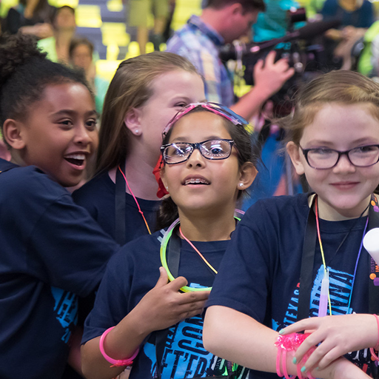
The Challenge Experience
Open to all kindergarten through university level students worldwide.
Student teams of up to seven members select their Challenge and work together to develop a solution.
Each team has at least one Team Manager to help keep the team on track, but does not assist or interfere with the team’s solution. This volunteer role is typically filled by a parent, teacher, or community member.
Teams share and celebrate their innovative Challenge solutions at an in-person or virtual tournament.
WHAT
Notes:
Image description: Four girls celebrate at Destination Imagination Global Finals.

Slide 7
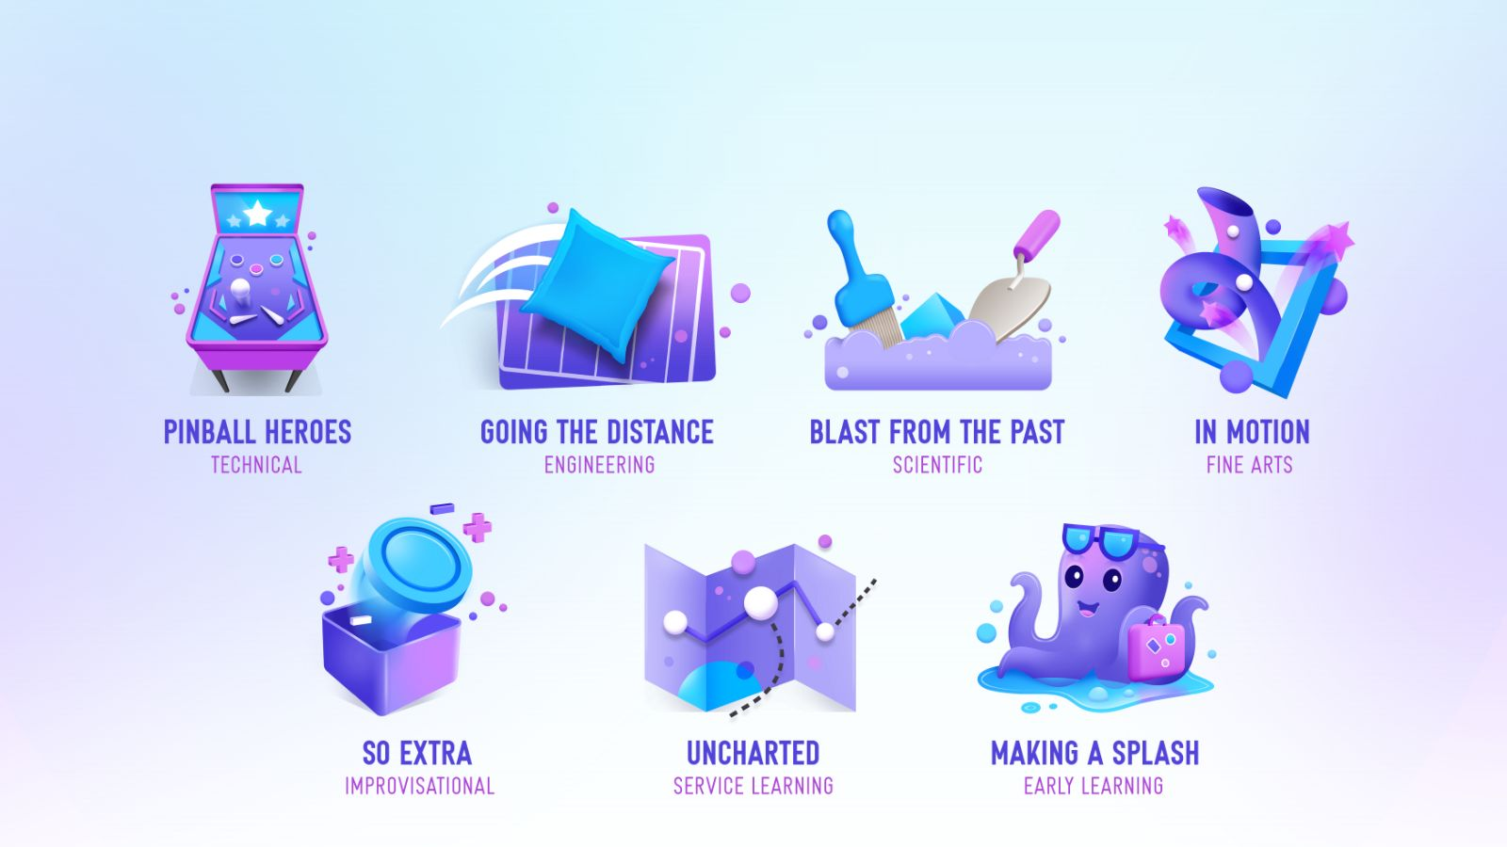
TEAM CHALLENGE CATEGORIES
WHAT
Notes:
Image description: The image shows the Team Challenge icons for the 23-24 season of Destination Imagination’s Challenge Experience.

Slide 8
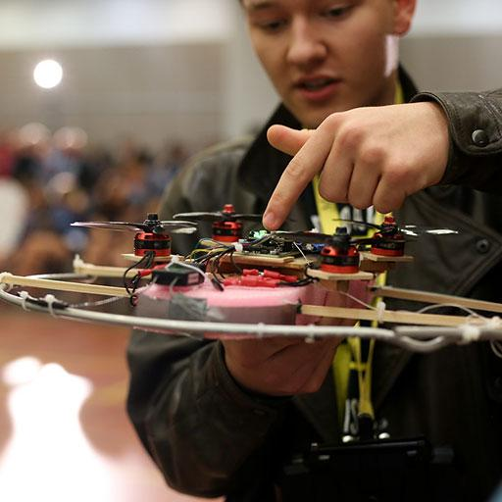
Action, adventure, challenges to overcome! See the lights flashing and listen to the buzzers and bells as your team brings a pinball game to life! Hone your pinball skills and aim for the high score when you try this year’s Technical Challenge!
Design and build a pinball system through which a pinball moves and interacts with 3 machine modules.
During the Presentation, move the pinball through the pinball system for as long as possible.
Create and present an action/adventure story about a hero who goes on an extraordinary mission.
Create and present two Team Choice Elements that show off the team’s interests, skills, areas of strength, and talents.
WHAT
Notes:
Image description: A student showcases his drone-like device for his team’s Challenge solution.

Slide 9
It’s a bird, it’s a plane…no…it’s a beanbag! Who can predict how far the beanbag will fly or where it will come to rest? In this season’s Engineering Challenge, you will test your accuracy as you launch beanbags using a launching device and tell a story about what happens when things do not go exactly as planned.
Design and build a modular device that will be assembled and then tested in two different configurations during the Presentation.
Complete launch tests to test how far and how accurately your modular device can launch a bean bag in each configuration.
Transform the modular device from one configuration to the other.
Create and present a story in which everything is going according to plan until a catalyst occurs.
Create and present two Team Choice Elements that show off the team’s interests, skills, areas of strength, and talents.
WHAT
Notes:
Image description: A high school student works on her prop for her team’s Challenge solution.

Slide 10
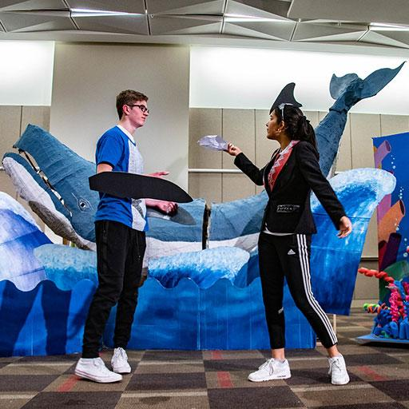
A broken jar, a bit of stone—the remains of the past are all around us. Have you ever wondered what those things might have been used for or what they meant to the people who made them? What archaeological mysteries will be revealed in this year’s Scientific Challenge?
Create and present a story about a character whose discovery of an artifact leads to a finding.
Include an archaeological investigation that contributes to the finding.
Design and create a puppet that will portray a character from the past.
Create and present two Team Choice Elements that show off the team’s interests, skills, areas of strength, and talents.
WHAT
Notes:
Image description: Two high school students are performing in their Challenge solution. Behind them is a large-scale whale they’ve created as a prop.

Slide 11
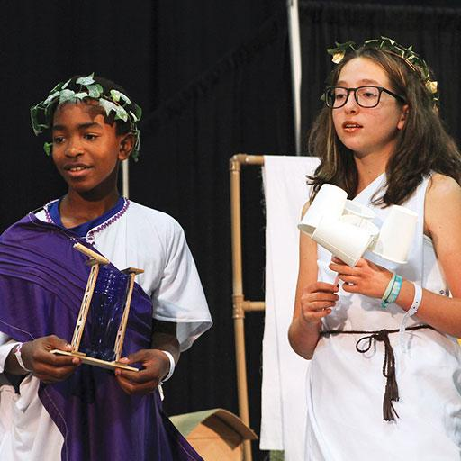
Art has the power to move us or stop us in our tracks. In this year’s Fine Arts Challenge, you will bring a work of visual art to life and create your very own piece of kinetic art. What work of art will inspire you?
Create and present a story inspired by a work of visual art.
Include a static character and a dynamic character in the story.
Reimagine the work of visual art as performance art and include the reimagined art in the Presentation.
Design and create one piece of kinetic art that uses technical methods to create movement.
Create and present two Team Choice Elements that show off the team’s interests, skills, areas of strength, and talents.
WHAT
Notes:
Image description: Two middle school students dressed in costumes for their Destination Imagination Presentation.

Slide 12
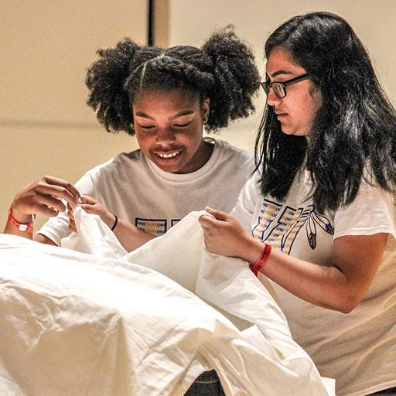
Sometimes less is more, or more is less…Your team will use your improv skills to create a 2-act skit, complete with a costume created on the spot! An intensifier will tell your team whether you’ll maximize or minimize elements of your skit in the second act. Find out how things will change with the toss of a coin in this year’s Improvisational Challenge!
Create and present a 2-act improvisational skit based on a scenario.
Incorporate a stock character into the skit.
Research costume design and use a costume design kit to create a costume.
Use an intensifier to minimize or maximize the scenario, stock character, and costume.
WHAT
Notes:
Image description: Two high school students work with a sheet as part of their Challenge solution.

Slide 13
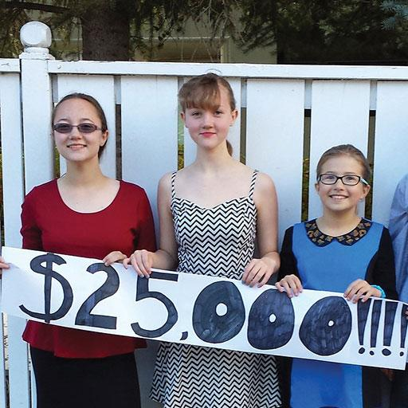
Your team will dive into a world of fantasy in this year’s Service Learning Challenge. Use a map to guide you on your quest, but beware of the danger that awaits! What will you seek? Fame? Fortune? Or to make the world a better place? The quest is about to begin!
Identify, design, carry out, and evaluate a project that addresses a need in a real community.
Create and present a fantasy story about a character who goes on a quest.
Design and create a fantasy map that uses technical methods to represent location information from the story.
Create and present two Team Choice Elements that show off the team’s interests, skills, areas of strength, and talents.
WHAT
Notes:
Image description: A Service Learning team holds up a sign stating that they’ve raised $25,000 as part of their team’s project.

Slide 14
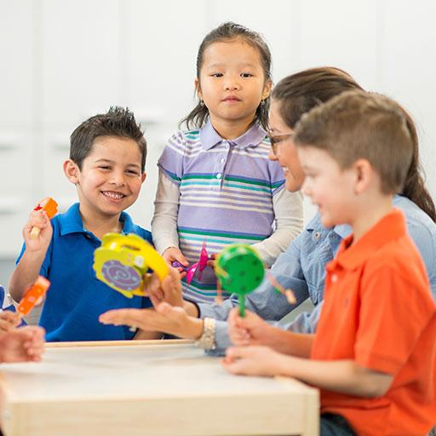
From the busy coral reef, to the inky depths of the midnight zone, to the shallows of a lake bed, there are lots of amazing underwater habitats to visit. Where might underwater creatures go for a vacation? Come explore life under the sea in this season’s Early Learning Challenge!
Research underwater habitats.
Create and present a play about a group of underwater creatures who go on vacation to an underwater habitat.
Design and build a model of a landmark the underwater creatures visit.
Create scenery to show the underwater habitat.
Create and present one Team Choice Element that shows off the team’s interests, skills, areas of strength, and talents.
WHAT
Notes:
Image description: A group of kids and a teacher are at a table, playing with musical instruments.

Slide 15
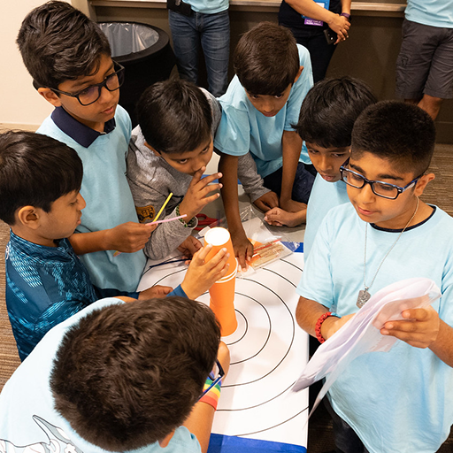
In a world with growing cultural connections, increased levels and types of communication, and a new need for real-time teamwork and problem-solving, the ability to solve problems quickly is becoming increasingly critical.
Each team will be asked to solve an Instant Challenge for their DI tournament. The team must think on their feet by applying appropriate skills to produce a solution in a short period of time.
Instant Challenges are performance-based, task-based, or a combination of the two. Although each Instant Challenge has different requirements, all Instant Challenges reward teams for their teamwork. Instant Challenges are kept confidential until it is time for teams to solve them.
WHAT
Notes:
Image description: A Destination Imagination team works on an Instant Challenge together.

Slide 16
Flying Feather
Challenge
Build the tallest possible structure, place a feather on the top, and then blow the feather off to land as far away as possible.
Time
You have 5 minutes to use your teamwork, creativity, and innovation skills to build the structure with the materials provided. You will then have one chance to blow the feather as far as you can.
The Scene
You have been asked to build a new prop for the sequel to The Muppets. The structure must be freestanding on the table top and must be as tall as possible so that the feather can fly a long distance. After the 5-minute build time, the height of the structure will be measured. You will then place the feather on the top of the structure and, with one large puff of air, see how far the feather will fly.
Materials
Aluminum foil, 2 paper clips, 4 straws, 3 sheets of paper, 4 pipe cleaners, 1 label, 1 feather
WHAT

Slide 17
The Digital Open is a virtual challenge designed for teams that want or need a flexible learning experience—in person, virtual, or hybrid. Each year, we create a unique challenge that requires a digital solution. Solutions are appraised and teams are ranked in this one-of-a-kind global competition.
Learn more at: DestinationImagination.org/Digital-Open
WHAT
Notes:
Remove this slide if you are presenting after Oct 11th

Slide 18
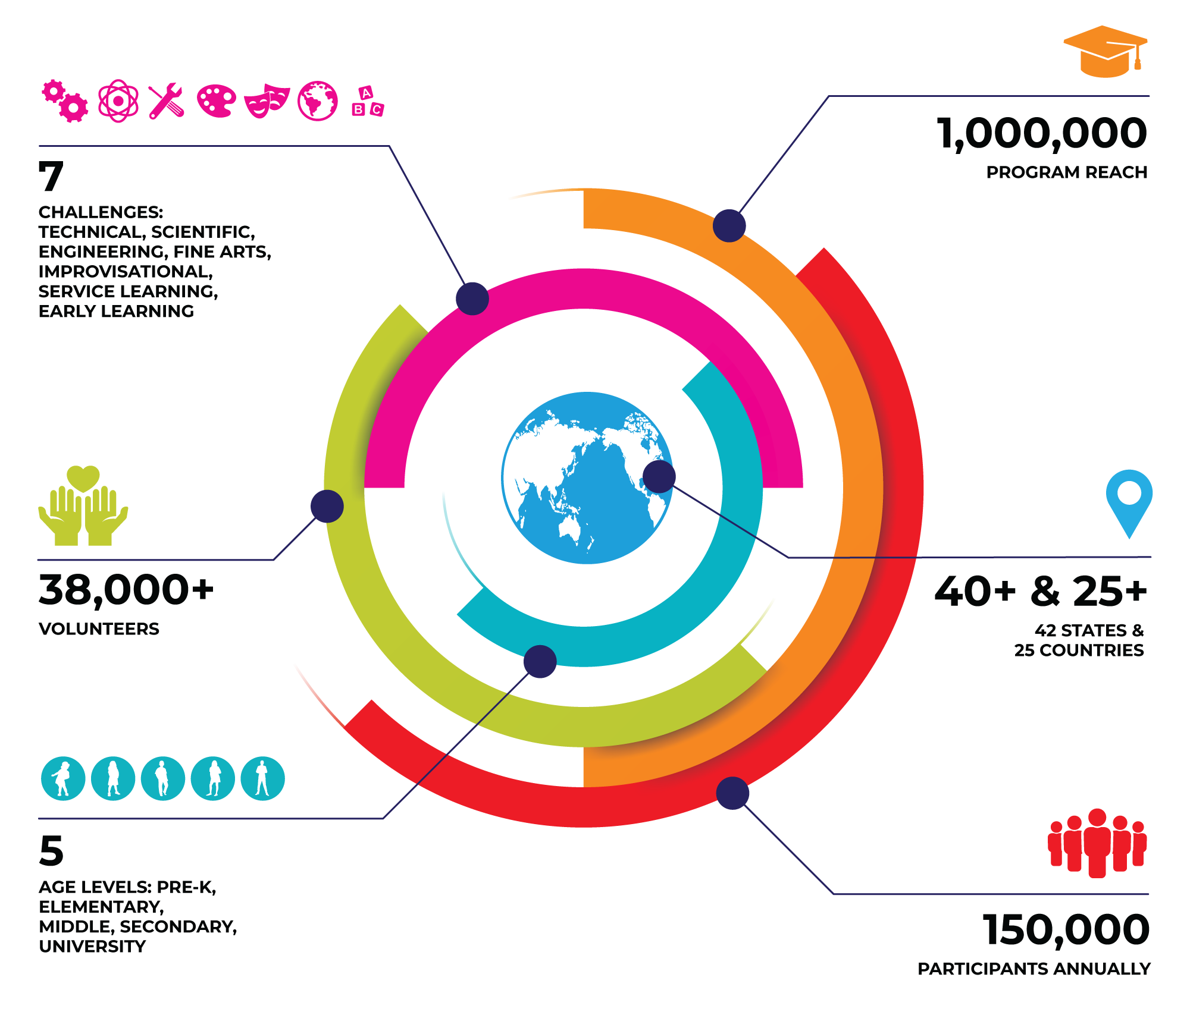
OUR
COMMUNITY
WHO
Notes:
Please note that these are our pre-pandemic numbers.

Slide 19
Who does Destination Imagination?
STUDENTS
TEACHERS & ADMINISTRATORS
VOLUNTEERS
PARENTS & GUARDIANS
ALUMNI
WHO

Slide 20
The Workforce of the Future
Though we don’t know what these jobs will look like, we know the skills that will be needed—skills that DI helps students gain, including creative problem-solving, critical thinking, and project management.
60% of CEOs polled cited creativity as the most important leadership quality, compared with 52% for integrity and 35% for global thinking.
– IBM Global CEO Study
65% of today’s students will be employed in jobs that have yet to be invented.
– U.S. Department of Labor
WHY

Slide 21
U.S. Team Pricing
Ready to get started? Visit ShopDI.org to purchase a Team Number.
TEAM NUMBER
$165*/ Per Team
BACKGROUND CHECK
$25/ For Team Managers
Destination Imagination administers its Team Challenges through state and country Affiliates worldwide. To participate in a tournament, teams must register with their Affiliate. There are additional fees for Affiliate administration, Affiliate Tournaments and Challenge budgets. Some Affiliates have directed DI headquarters to collect their Affiliate fees* with the purchase of your Team Number.
*Affiliate fees vary and are at the discretion of each individual Affiliate.
HOW

Slide 22
Team Number Volume Discounts
Buy 10 or MORE Team Numbers and Save!
10-19
TEAM NUMBERS
20-49
TEAM NUMBERS
50-99
TEAM NUMBERS
100+
TEAM NUMBERS
SAVE 5%
SAVE 10%
SAVE 15%
SAVE 20%
HOW

Slide 23
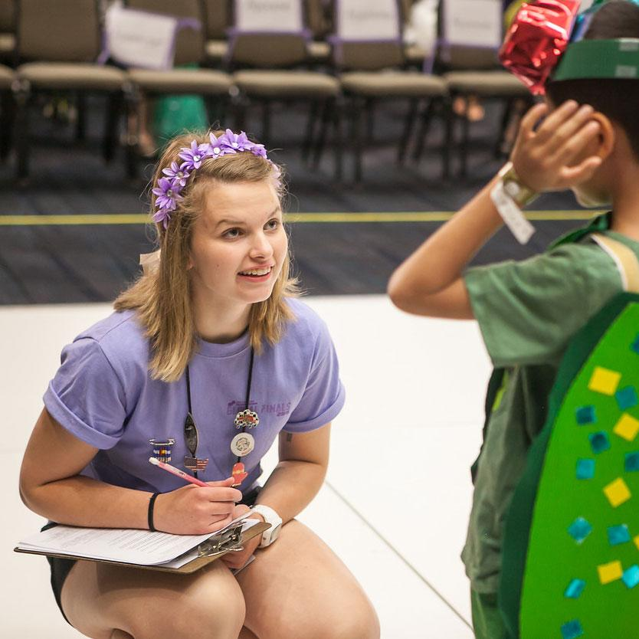
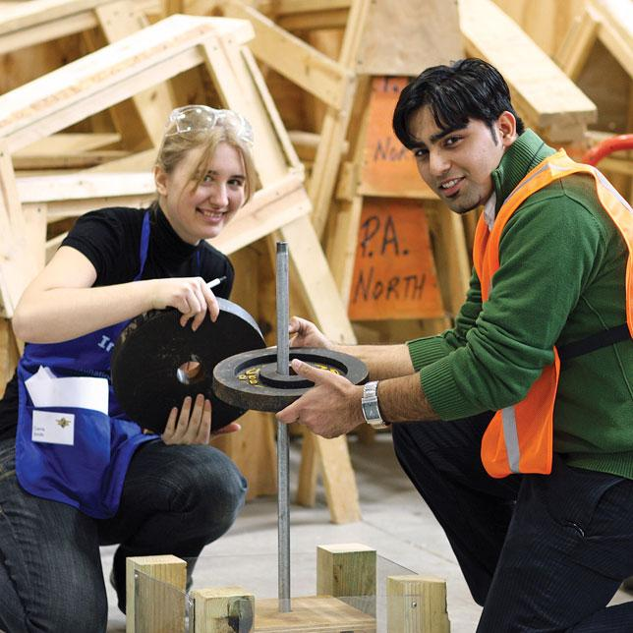
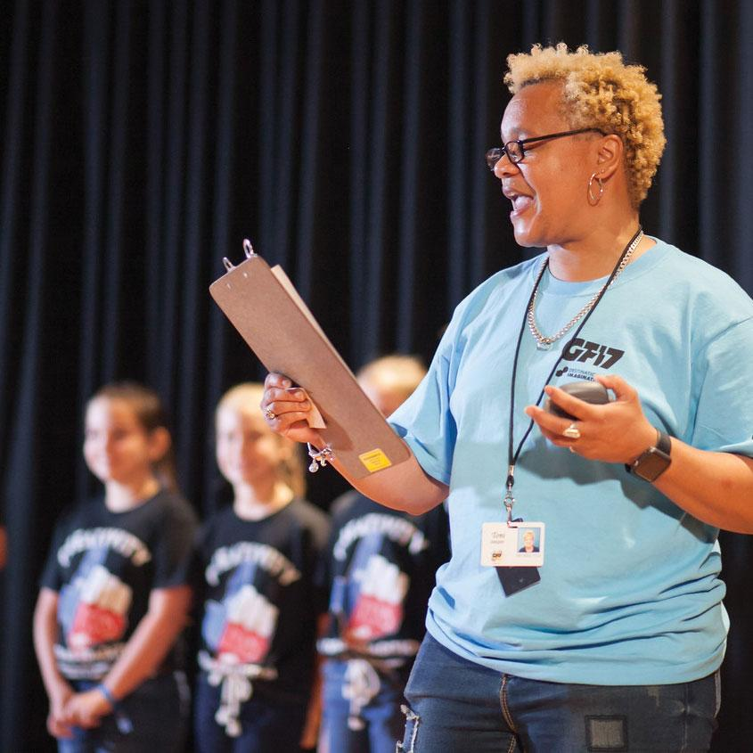
Volunteer Opportunities
Being a DI volunteer allows you to connect with a growing network of engaged and passionate individuals who believe that the power of creativity can impact the lives of our learners. To learn more about the various volunteer opportunities within DI, visit DestinationImagination.org/Volunteer.
HOW
Notes:
Image description: On the left, a DI volunteer speaks with a DI student after their performance. In the center, two DI students pose for a photo, smiling and working together on their structure tester. On the right, a DI volunteer announces an Improv team that is about to perform.

Slide 24
Questions
Thank you! For additional information, please contact:
HOW

