Slide 1


A STEAM program for pre-K, K-12 and university students
TRANSFORMING EDUCATION
ONE CHALLENGE AT A TIME

Slide 2






AGENDA
WHAT
WHO
WHY
HOW
QUESTIONS

Slide 3







What is
Destination
Imagination?
Self-Confidence
Destination Imagination (DI) is an educational nonprofit.
Our mission is to inspire and equip youth to imagine and innovate through the creative process.
We want to ignite the power of ALL youth to be the creative and collaborative innovators of tomorrow.
Problem Solving
Team Building
Creative & Critical Thinking
Perseverance
Project Management
Risk Taking
WHAT

Slide 4

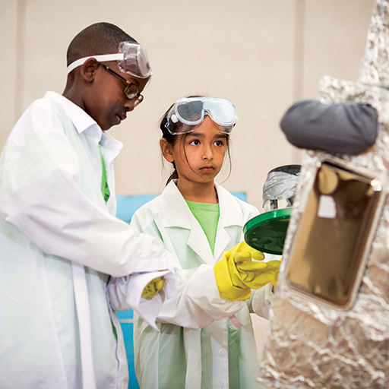
DI’s Challenge Experience is a project-based academic competition in which students work in teams to solve open-ended Challenges.
Each of our seven, annual Team Challenges has a different educational focus:
  Scientific
  Technical
  Engineering
  Fine Arts
  Improvisational
  Service Learning
  Early Learning
WHAT
Notes:
Image description: Two middle school students dressed in lab coats and safety goggles working together on their Destination Imagination Presentation.

Slide 5
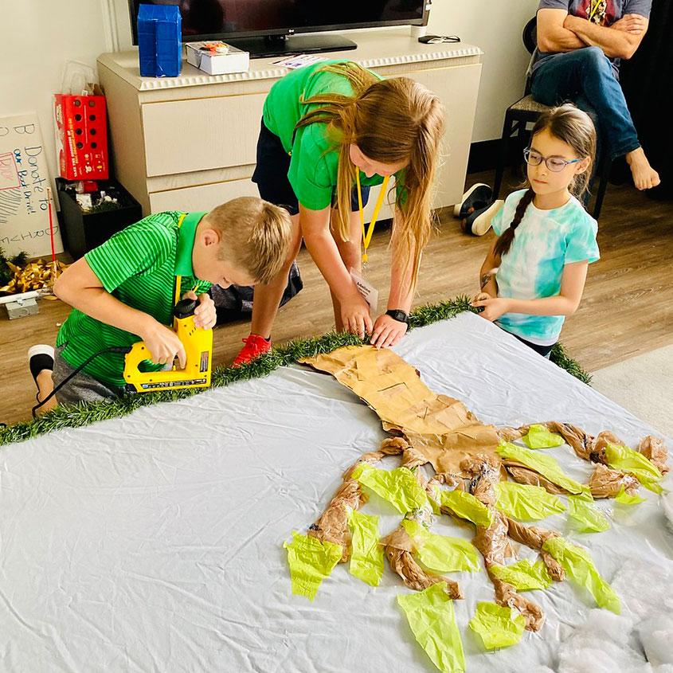
Each team selects one of our Team Challenges, and then works on their solution over several weeks or months.
A solution is a presentation that is then brought to a local tournament to be scored and celebrated.
As students work together, they get to explore their passions, discover their own talents and abilities, and learn life skills.
WHAT
Notes:
Image description: Three students work together on their Destination Imagination props, using power tools to create scenery.

Slide 6
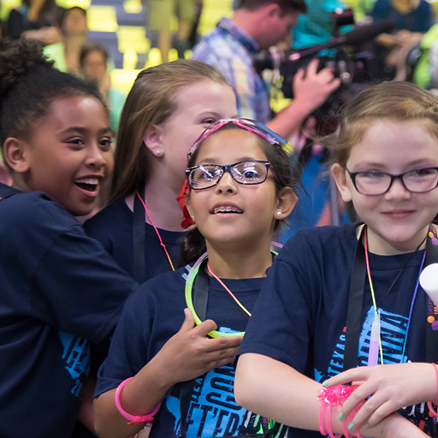

The Challenge Experience
Open to all kindergarten through university level students worldwide.
Student teams of up to seven members select their Challenge and work together to develop a solution.
Each team has at least one Team Manager to help keep the team on track, but does not assist or interfere with the team’s solution. This volunteer role is typically filled by a parent, teacher, or community member.
Teams share and celebrate their innovative Challenge solutions at an in-person or virtual tournament.
WHAT
Notes:
Image description: Four girls celebrate at Destination Imagination Global Finals.

Slide 7
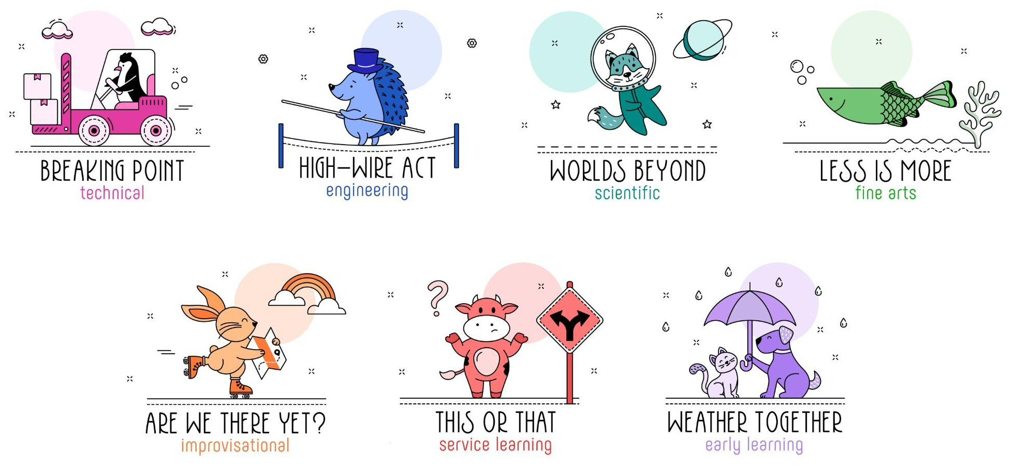
TEAM CHALLENGE CATEGORIES
WHAT
Notes:
Image description: The image shows the Team Challenge icons for the 23-24 season of Destination Imagination’s Challenge Experience.

Slide 8
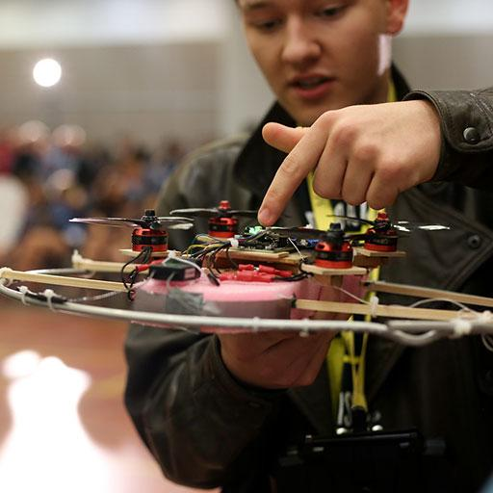

Design and build assembly equipment and destruction equipment.
Use the assembly equipment to create a stack of items.
Use the destruction equipment to disassemble and/or destroy the stack.
Create and present a story about a character who lacks something important and attempts to gain it.
Create and present two Team Choice Elements that show off the team’s interests, skills, areas of strength, and talents.
WHAT
Notes:
Image description: A student showcases his drone-like device for his team’s Challenge solution.
Challenge Teaser: Build it up and knock it down! In this Challenge, your team will go from the highest heights to the lowest lows as you use team-created equipment to build and destroy stacks of items. What will a character do when their greatest wishes encounter a frustration point? Will it all come tumbling down? Find out in this season’s Technical Challenge!

Slide 9
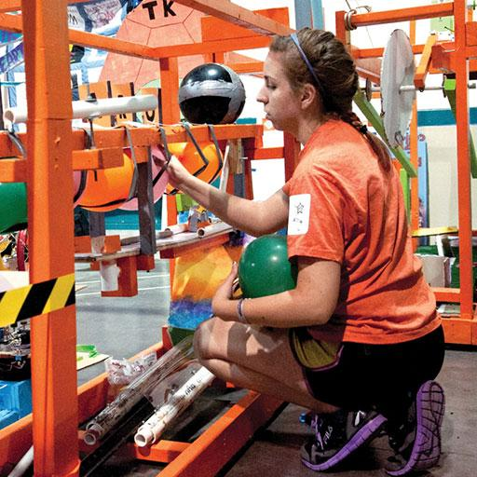

Design and build a transporter that will be tested during the team’s Presentation.
Complete weight transport tests to test how much weight the transporter can carry along a tournament-provided cord at various angles.
Create and present a story in the style of contemporary circus.
Include a daring display and an ensemble spectacle in the Presentation.
Create and present two Team Choice Elements that show off the team’s interests, skills, areas of strength, and talents.
WHAT
Notes:
Image description: A high school student works on her prop for her team’s Challenge solution.
Challenge Teaser: Come one, come all to the greatest show on Earth! Join us for a daring feat of high-wire innovation as you test a transporter that will carry weights along a tournament-provided cord. Present a story in the style of contemporary circus and don’t forget to include a daring display! This season’s Engineering Challenge isn’t clowning around!

Slide 10

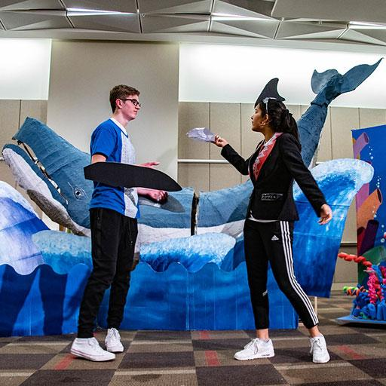
Create and present a story in which a character who is located on a planet other than Earth thinks they are alone but discovers that they are not.
Include technobabble in the story.
Design and build a device and/or effect that demonstrates what the technobabble describes.
Include a scientific demonstration that shows the science behind why a specific phenomenon of the planet happens and/or exists.
Create and present two Team Choice Elements that show off the team’s interests, skills, areas of strength, and talents.
WHAT
Notes:
Image description: Two high school students are performing in their Challenge solution. Behind them is a large-scale whale they’ve created as a prop.
Challenge Teaser: Space, the final frontier…join us for this season’s Scientific Challenge as you explore the cosmos. Your team will tell a story about a character who figures out they are not alone on a planet. Show off your science fiction skills with some out-of-this-world technobabble. What will happen when you go beyond the stars?

Slide 11
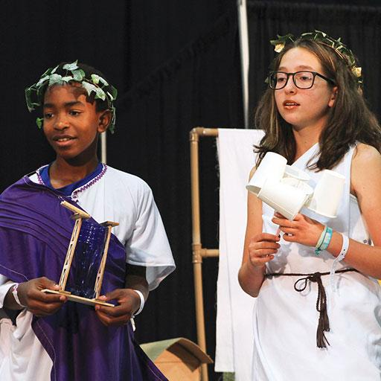

Create and present a story about how something small and/or simple can create a big impact.
Include a focal character in the story.
Include an emotional moment in the story.
Design and create a minimalist set.
Create and present two Team Choice Elements that show off the team’s interests, skills, areas of strength, and talents.
WHAT
Notes:
Image description: Two middle school students dressed in costumes for their Destination Imagination Presentation.
Challenge Teaser: How can the simplest of things convey the most? Your team will tell a story about something small that can have a big impact and move the audience with an emotional moment. Be strategic with your use of color and shape as you design a big visual impact with your set. It’s time to explore minimalism in this season’s Fine Arts Challenge!

Slide 12
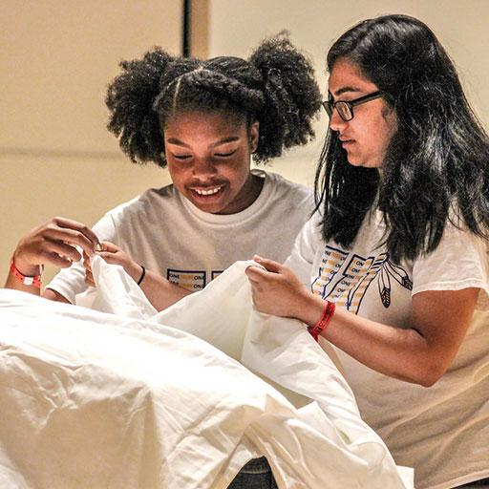

Create and present an improvisational skit about a traveling character.
Research locations and show the character’s route between a starting location and an ending location.
Research modes of transportation and incorporate one into the skit.
Include a seeker and a detour in the skit.
WHAT
Notes:
Image description: Two high school students work with a sheet as part of their Challenge solution.
Challenge Teaser: From beginning to end, we must travel a path to get where we want to go! Use your improvisational skills to tell a story about a character traveling between two locations. Include a character who is trying to find something and a detour that causes an unforeseen change in the plan or route. It’s time to hit the road with this season’s Improvisational Challenge!

Slide 13
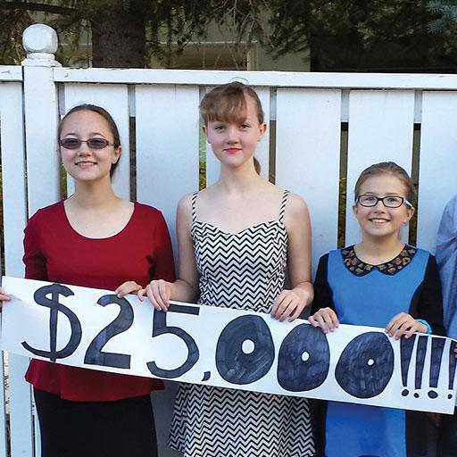

Identify, design, carry out, and evaluate a project that addresses a need in a real community.
Create and present a story about a character who must make a critical choice.
Include at least two potential outcomes and a complication in the story.
Include a device that completes two different tasks from the same initiation in the Presentation.
Create and present two Team Choice Elements that show off the team’s interests, skills, areas of strength, and talents.
WHAT
Notes:
Image description: A Service Learning team holds up a sign stating that they’ve raised $25,000 as part of their team’s project.
Challenge Teaser: Left or right, apple or orange, smile or frown…the world is full of choices! Your team will tell a story about a character who must make a critical choice after considering potential outcomes. A binary device will enhance your Presentation by completing two tasks at once! Where will your decisions lead in this season’s Service Learning Challenge?

Slide 14
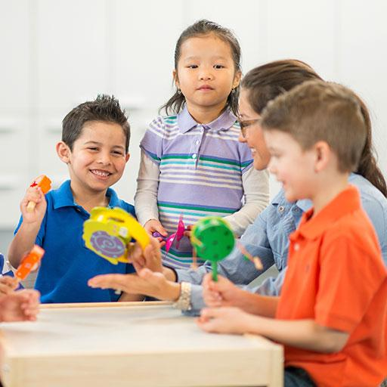

Research different kinds of weather.
Create and present a play about a character learning about a kind of weather for the very first time.
Include a teacher character and a special weather activity in the story.
Design and create a weather costume and a weather special effect.
Create and present one Team Choice Element that shows off the team’s interests, skills, areas of strength, and talents.
WHAT
Notes:
Image description: A group of kids and a teacher are at a table, playing with musical instruments.
Challenge Teaser: Rain, snow, wind, sun, and hail! There are so many different kinds of weather and lots of wonderful activities that can only be done during the perfect kind of weather. Your team will tell a story about a character who is learning about one kind of weather for the very first time. It’s a great day for some outdoor fun!

Slide 15
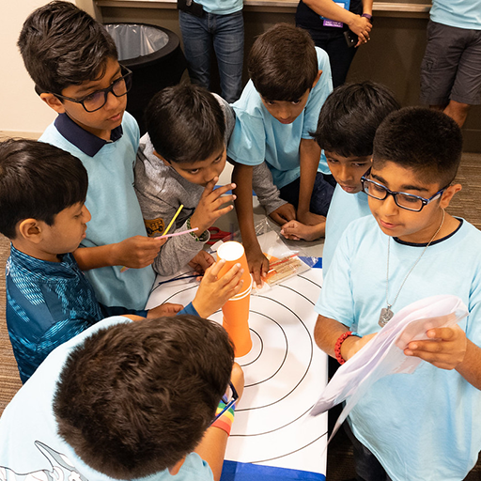

In a world with growing cultural connections, increased levels and types of communication, and a new need for real-time teamwork and problem-solving, the ability to solve problems quickly is becoming increasingly critical.
Each team will be asked to solve an Instant Challenge for their DI tournament.
Instant Challenges are kept confidential until it is time for teams to solve them.
WHAT
Notes:
Image description: A Destination Imagination team works on an Instant Challenge together.

Slide 16

Flying Feather
Challenge
Build the tallest possible structure, place a feather on the top, and then blow the feather off to land as far away as possible.
Time
You have 5 minutes to use your teamwork, creativity, and innovation skills to build the structure with the materials provided. You will then have one chance to blow the feather as far as you can.
The Scene
You have been asked to build a new prop for the sequel to The Muppets. The structure must be freestanding on the table top and must be as tall as possible so that the feather can fly a long distance. After the 5-minute build time, the height of the structure will be measured. You will then place the feather on the top of the structure and, with one large puff of air, see how far the feather will fly.
Materials
Aluminum foil, 2 paper clips, 4 straws, 3 sheets of paper, 4 pipe cleaners, 1 label, 1 feather
WHAT

Slide 17


In this filmmaking adventure, students will discover the power of their own creativity and work together as a team to turn their imagination into a force for ingenious problem-solving and storytelling.
Teams will base their films on a unique challenge to solve, encouraging innovative solutions and showcasing the power of teamwork. The catch? They have just 8 weeks to make it happen!
Solutions are appraised and teams are ranked in this one-of-a-kind global competition.
Learn more at: Destinationimagination.org/TFC
WHAT
Notes:
Remove this slide if you are presenting after Oct 11th

Slide 18
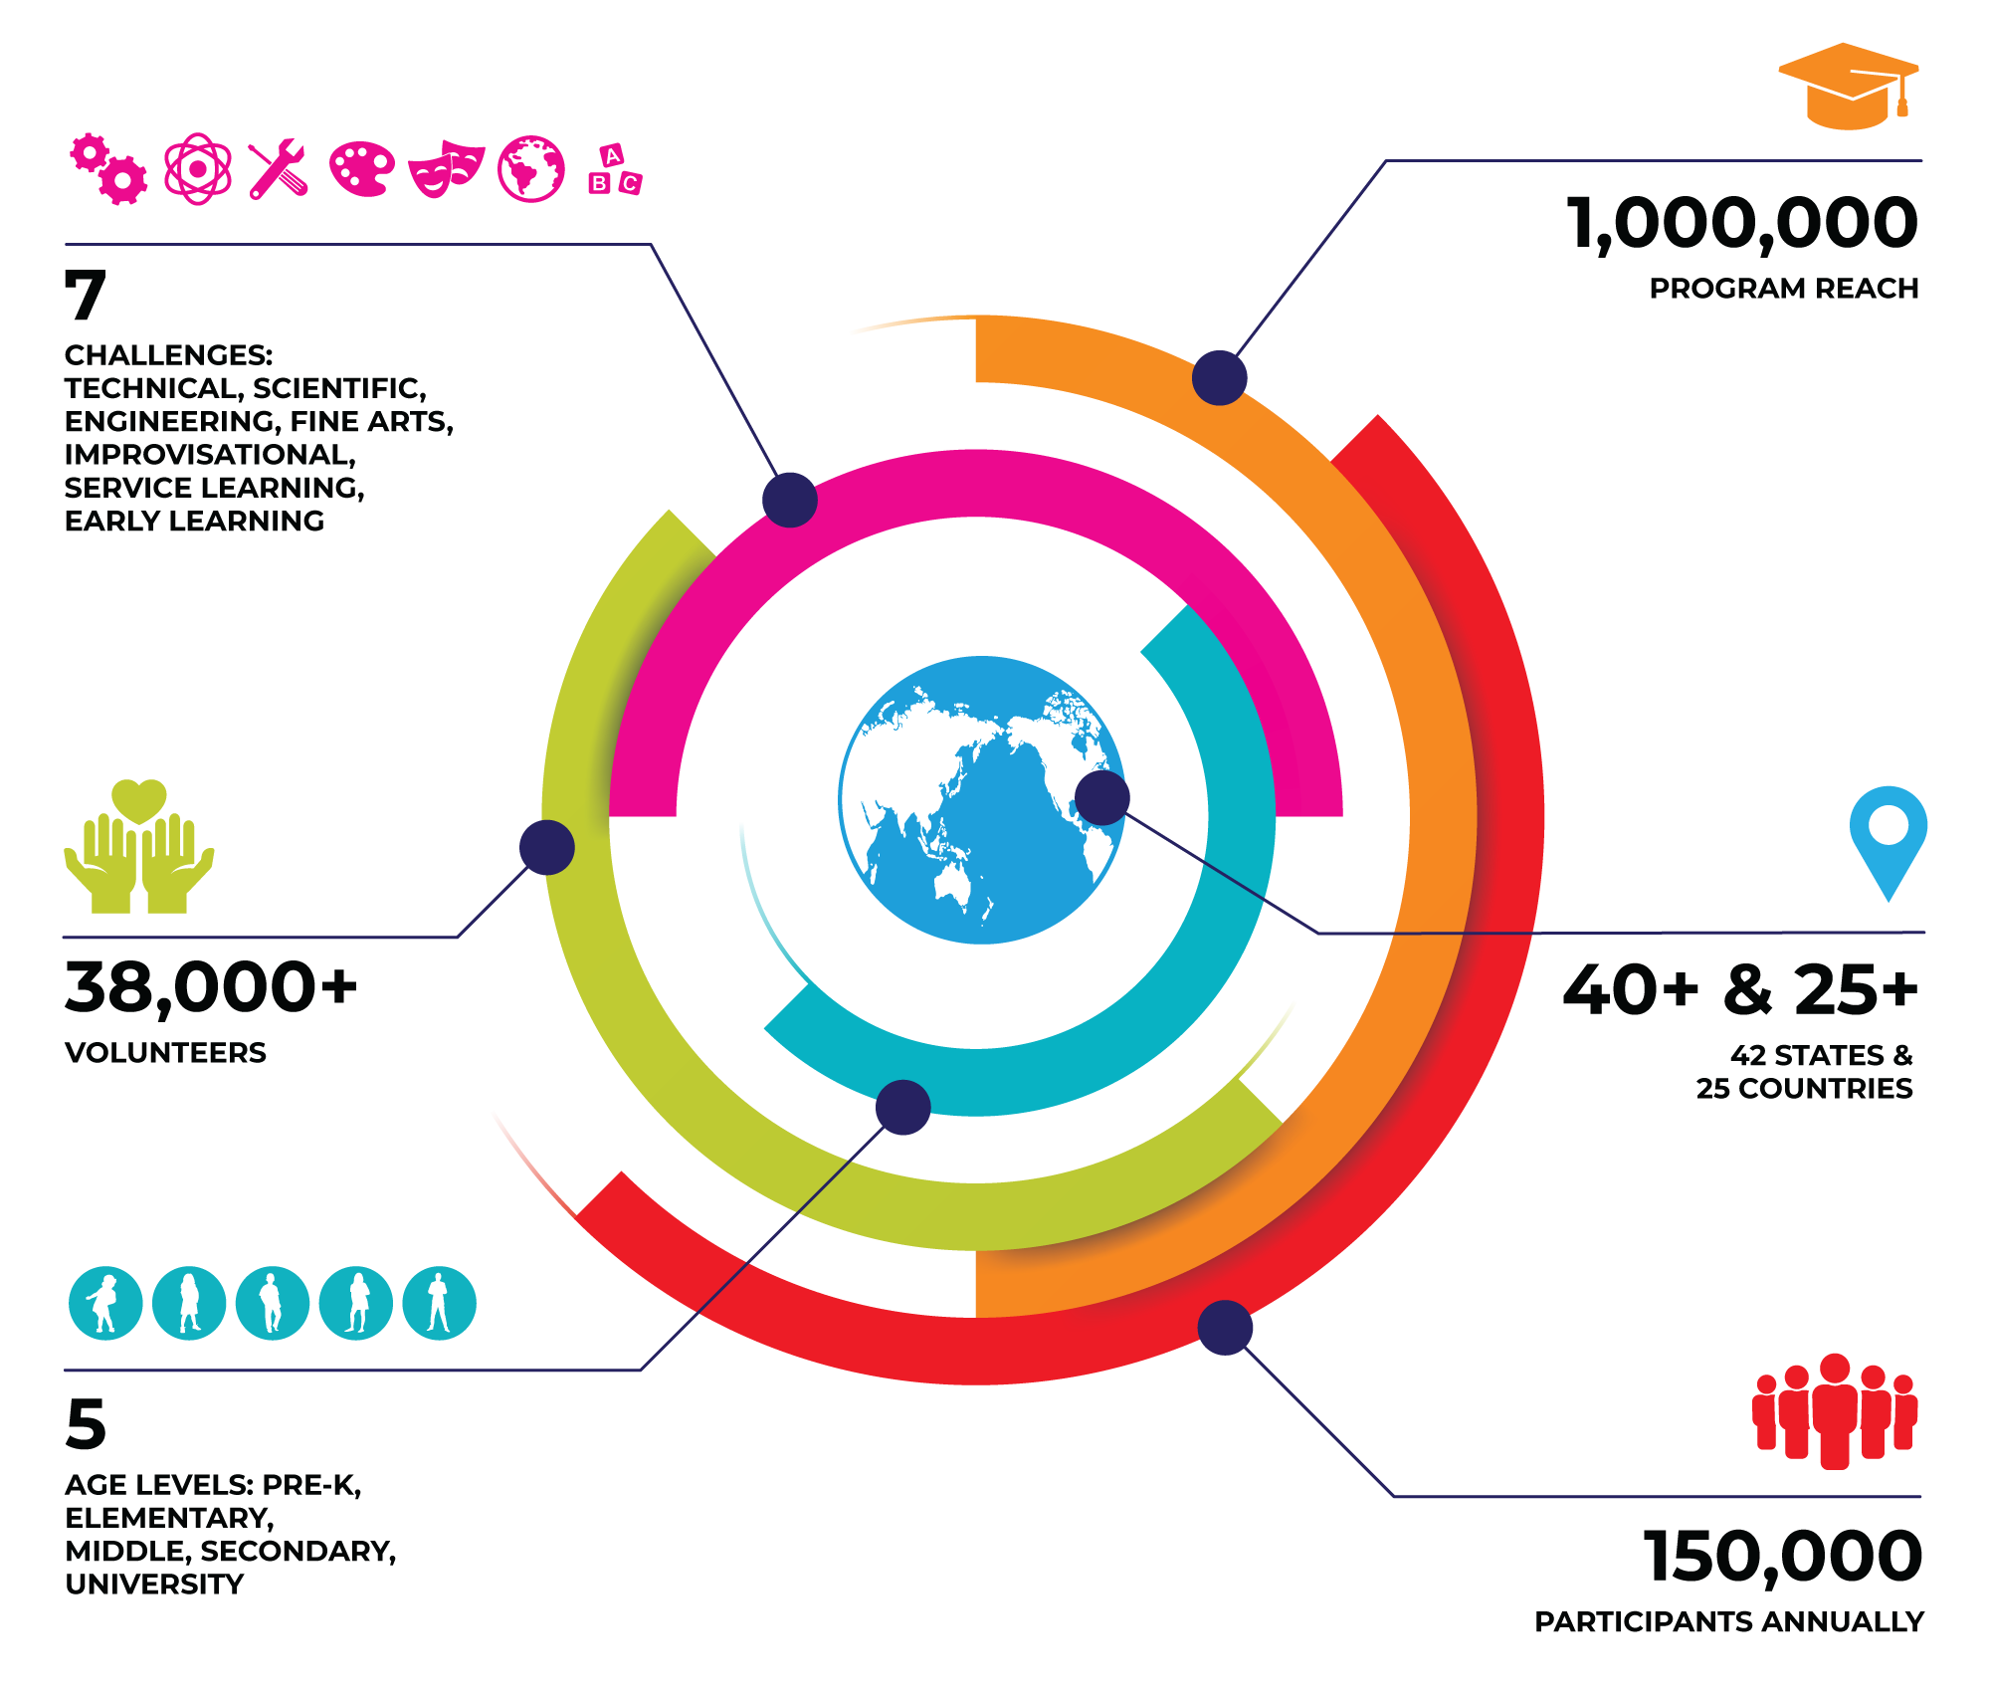
OUR
COMMUNITY
WHO
Notes:
Please note that these are our pre-pandemic numbers.

Slide 19





Who does Destination Imagination?
STUDENTS
TEACHERS & ADMINISTRATORS
VOLUNTEERS
PARENTS & GUARDIANS
ALUMNI
WHO

Slide 20


The Workforce of the Future
Though we don’t know what these jobs will look like, we know the skills that will be needed—skills that DI helps students gain, including creative problem-solving, critical thinking, and project management.
60% of CEOs polled cited creativity as the most important leadership quality, compared with 52% for integrity and 35% for global thinking.
– IBM Global CEO Study
65% of today’s students will be employed in jobs that have yet to be invented.
– U.S. Department of Labor
WHY

Slide 21
U.S. Team Pricing
Ready to get started? Visit ShopDI.org to purchase a Team Number.
TEAM NUMBER
$165*/ Per Team
BACKGROUND CHECK
$25/ For Team Managers
Destination Imagination administers its Team Challenges through state and country Affiliates worldwide. To participate in a tournament, teams must register with their Affiliate. There are additional fees for Affiliate administration, Affiliate Tournaments and Challenge budgets. Some Affiliates have directed DI headquarters to collect their Affiliate fees* with the purchase of your Team Number.
*Affiliate fees vary and are at the discretion of each individual Affiliate.
HOW

Slide 22
Team Number Volume Discounts
Buy 10 or MORE Team Numbers and Save!
10-19
TEAM NUMBERS
20-49
TEAM NUMBERS
50-99
TEAM NUMBERS
100+
TEAM NUMBERS
SAVE 5%
SAVE 10%
SAVE 15%
SAVE 20%
HOW

Slide 23
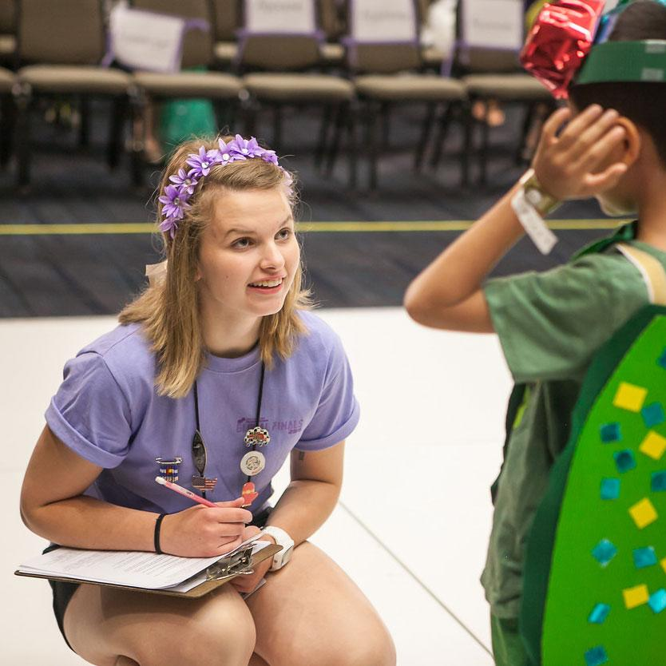
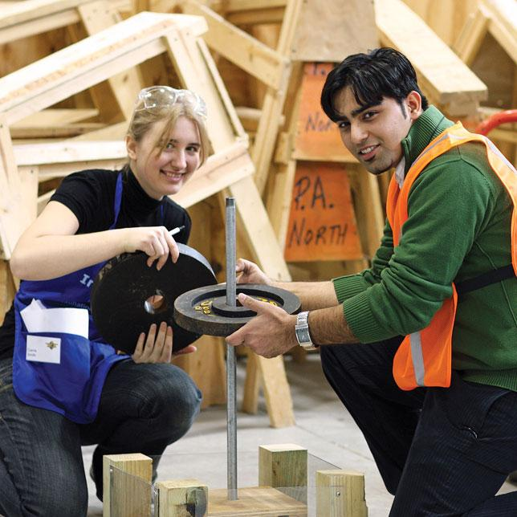
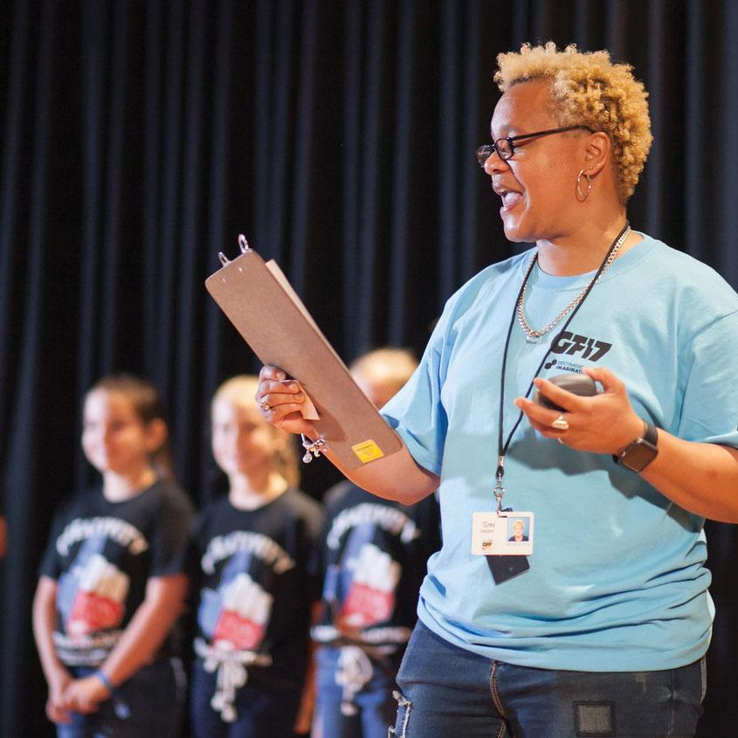
Volunteer Opportunities
Being a DI volunteer allows you to connect with a growing network of engaged and passionate individuals who believe that the power of creativity can impact the lives of our learners. To learn more about the various volunteer opportunities within DI, visit DestinationImagination.org/Volunteer.
HOW
Notes:
Image description: On the left, a DI volunteer speaks with a DI student after their performance. In the center, two DI students pose for a photo, smiling and working together on their structure tester. On the right, a DI volunteer announces an Improv team that is about to perform.

Slide 24
Questions
Thank you! For additional information, please contact:
HOW

